Slide 1
BREAST CANCER DEEP LEARNING
PRERSENTED BY:
MOHAN R
513121104701
III YEAR CSE
TPGIT ,VELLORE

Slide 2
OUTLINE
PROBLEM STATEMENT
PROPOSED SOLUTION
SYSTEM DEVELOPMENT APPROACH
ALGORITHM AND DEPLOYMENT
RESULT
CONCLUSION
REFERENCES

Slide 3
PROBLEM STATEMENT
Breast cancer remains one of the most prevalent and deadly forms of cancer worldwide, affecting millions of women each year. While advancements in medical research and treatment have improved survival rates, early detection and accurate prognostic assessments remain critical in optimizing patient outcomes.

Slide 4
PROPOSED SOLUTION
Data Size: The Wisconsin Diagnostic Breast Cancer dataset is a good starting point, but it's relatively small. Consider using larger and more diverse datasets for improved model generalizability.
Model Selection: Explore different neural network architectures beyond the basic sequential model. Convolutional Neural Networks (CNNs) might be particularly suitable if the dataset includes mammogram images.
Hyperparameter Tuning: Experiment with different hyperparameters like the number of layers, neurons per layer, learning rate, and dropout rate to optimize model performance. Techniques like GridSearch csv can be used for systematic exploration.
Evaluation Metrics: While accuracy is a common metric, consider using metrics like precision, recall, and F1-score to get a more comprehensive picture of the model's performance, especially for imbalanced datasets where one class (e.g., malignant) might be less frequent.

Slide 5
SYSTEM APPROACH
Data Acquisition: This involves defining the data source (e.g., medical databases, clinical trials). Considerations include data quality, format (structured vs. unstructured), and potential biases.
Data Preprocessing: This includes cleaning the data (handling missing values, outliers), feature engineering (creating new features), and potentially data transformation (scaling, normalization).
Model Development: This focuses on building the neural network model, including architecture selection, hyperparameter tuning, training on the prepared data, and monitoring performance metrics.

Slide 6
ALGORITHM
*Data Splitting
Divide the dataset into features (X) and target labels (y).
Split the data into training and testing sets using train_test_split() function from sklearn.model_selection.
*Feature Scaling
Standardize the features using StandardScaler() from sklearn.preprocessing.
*Model Building:
Initialize a Sequential model using Sequential() from keras.models.
Add layers to the model using Dense() from keras.layers. Two hidden layers and one output layer are added with appropriate activation functions (ReLU for hidden layers and sigmoid for the output layer).
Add dropout layers using Dropout() to prevent overfitting.
*Model Compilation:
Compile the model using compile() method specifying optimizer, loss function, and evaluation metrics.
*Model Training:
Train the model on the training data using fit() method. Specify the number of epochs and batch size.

Slide 7
DEPLOYMENT
Exploratory Data Analysis (EDA):
This section explores the data using various techniques:
Checking the data shape (data.head())
Analyzing data distribution with histograms (sns.distplot) and kernel density plots (sns.kdeplot)
Checking for missing values (sns.heatmap)
Data Preprocessing:
Splitting the data into features (X) and target variables (y).
Splitting data further into training and testing sets (train_test_split).
Feature scaling (StandardScaler) to normalize the features for better training.

Slide 8
RESULTS
Complete blood count (CBC) measures the number of red blood cells, white blood cells, and platelets in your blood.​
Blood smear examines the size, shape, and maturity of your blood cells under a microscope.​
Flow cytometry uses antibodies to identify specific proteins on the surface of your blood cells.​
Cytogenetic testing analyzes your chromosomes for abnormalities.​
Molecular testing looks for specific gene mutations that can cause blood cancer.​

Slide 9
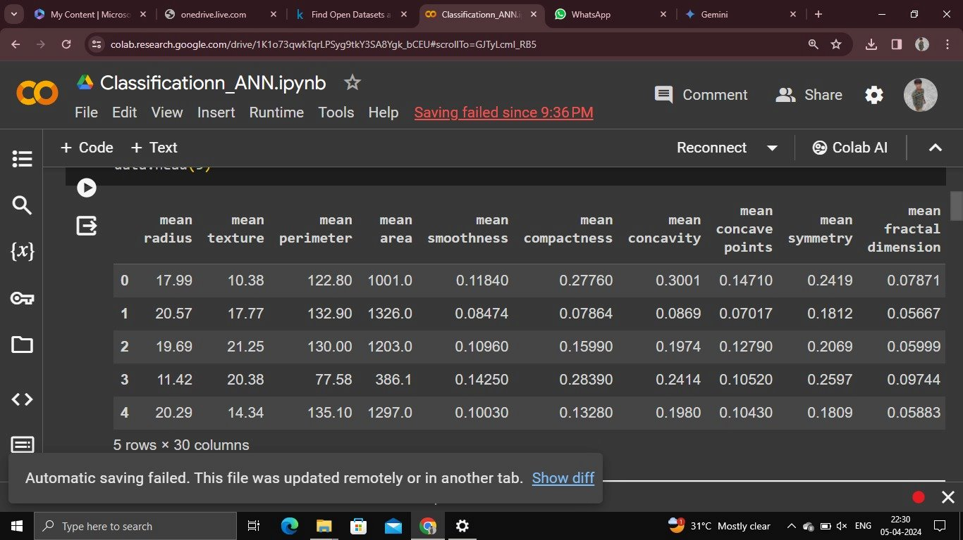
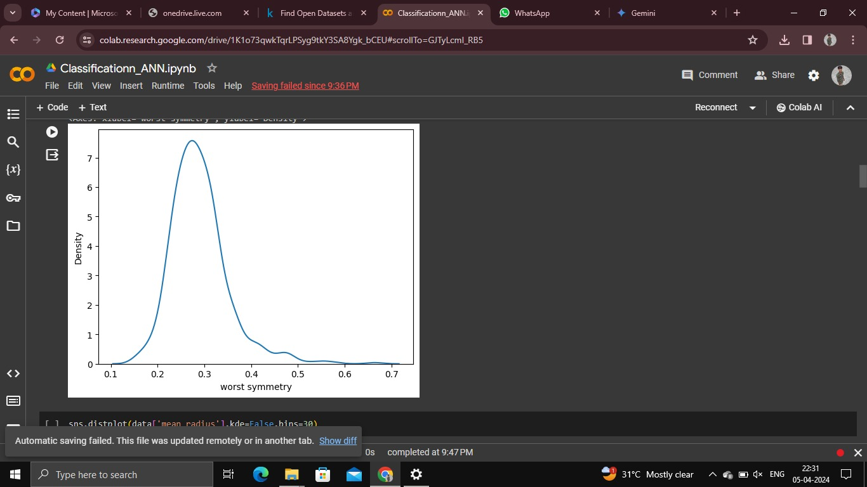
OUTPUT

Slide 10
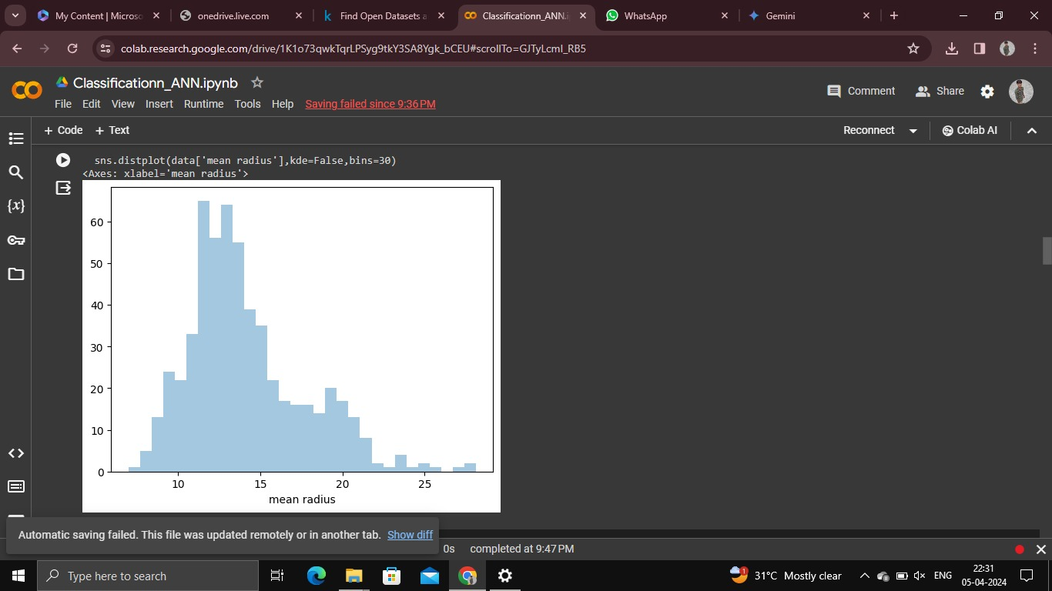
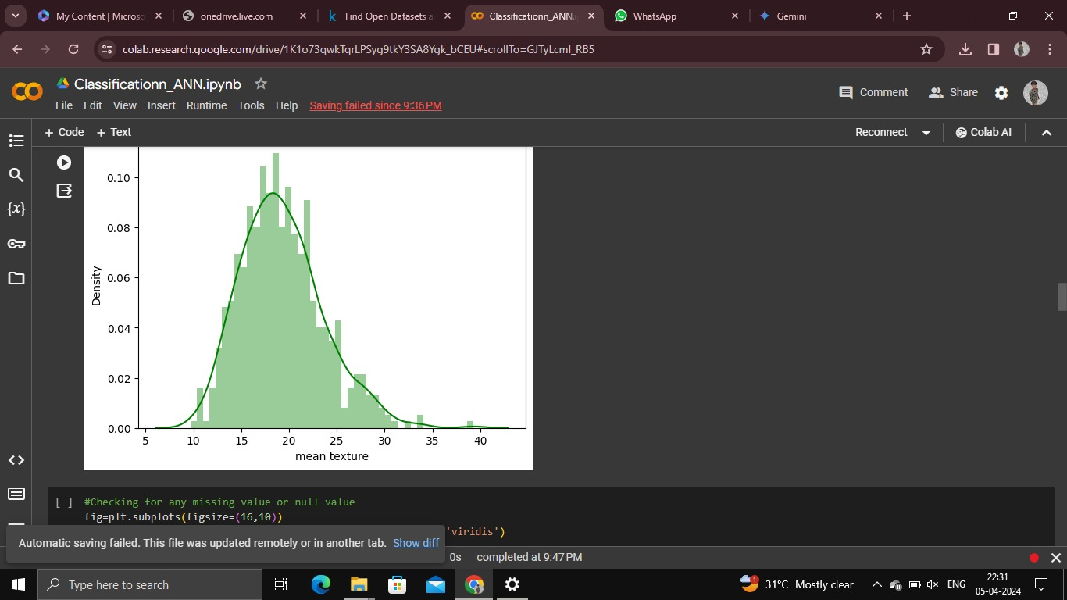
OUTPUT

Slide 11
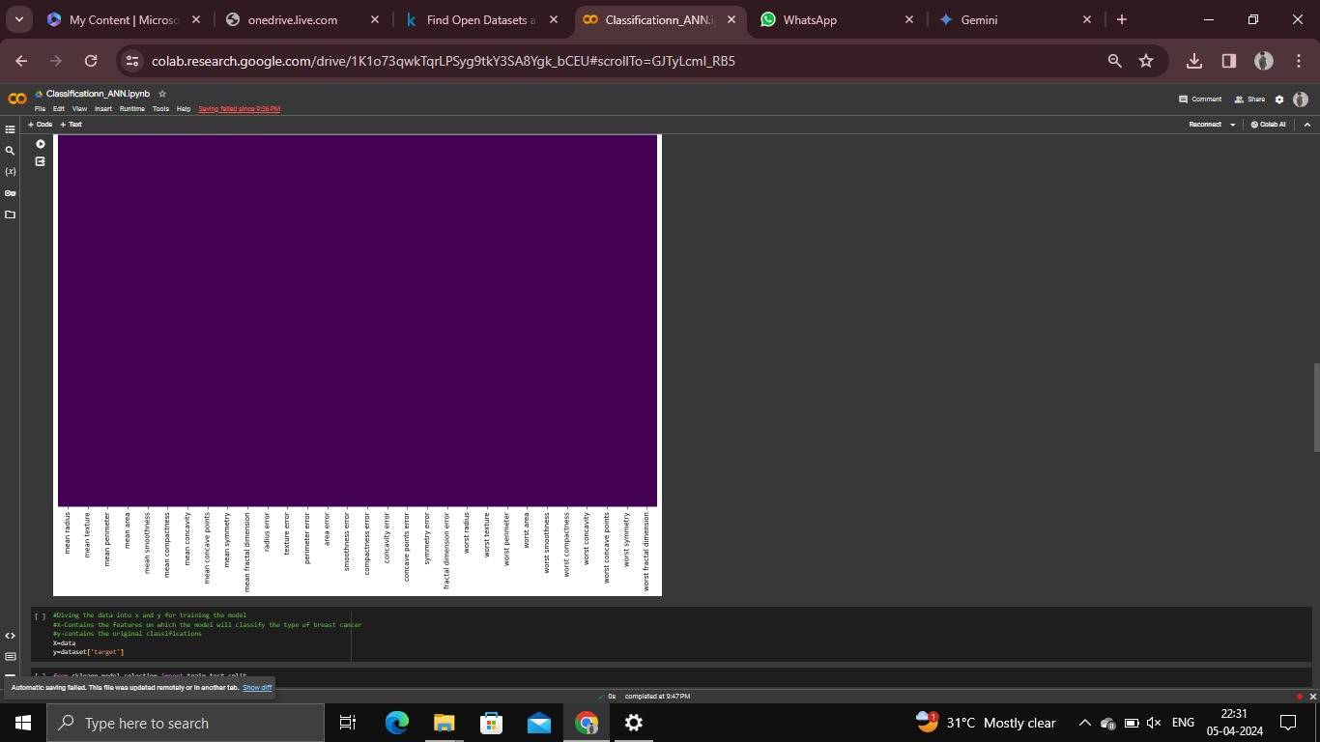
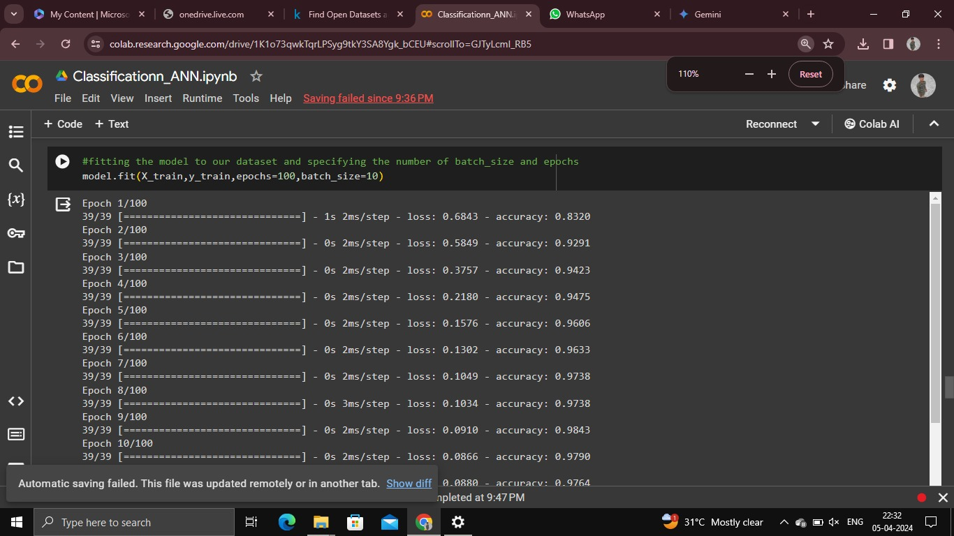
OUTPUT

Slide 12
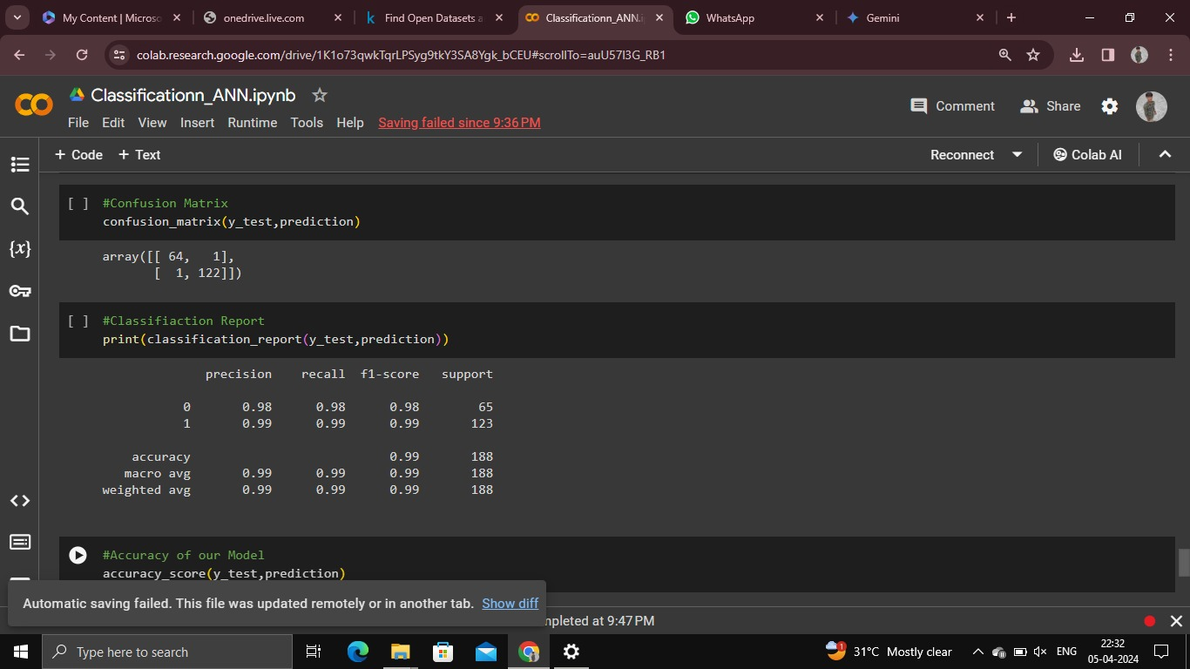
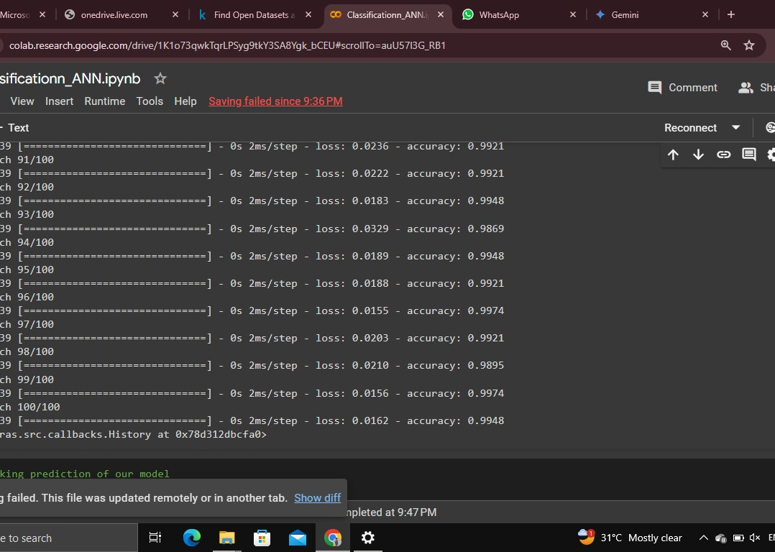
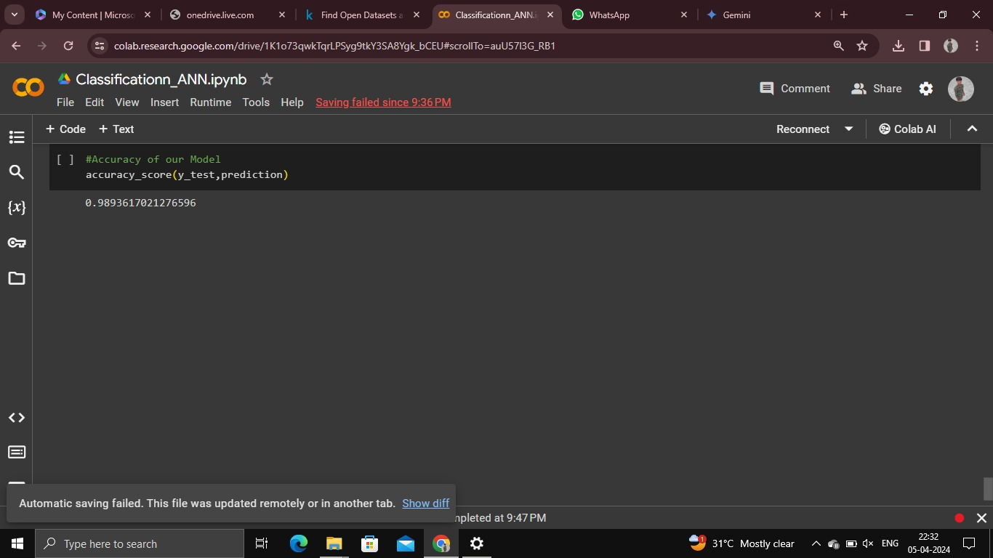
OUTPUT

Slide 13
CONCLUSION
In this breast cancer deep learning project, we employed advanced generative AI techniques, specifically Generative Adversarial Networks (GANs), to enhance the detection and diagnosis of breast cancer through mammography images. By leveraging the power of GANs for data augmentation, image enhancement, and semi-supervised learning, we aimed to improve the robustness and accuracy of our classification models
The project successfully demonstrated the potential of deep learning in assisting medical professionals in early detection, diagnosis, and prognosis prediction of breast cancer. Through the development and validation of deep learning models, we have made significant strides towards improving the efficiency and effectiveness of breast cancer screening and management.

Slide 14
REFERENCE
Chollet, F. (2018). Deep Learning with Python. Manning Publications Co.
McKinney, W. (2018). Python for Data Analysis: Data Wrangling with Pandas, NumPy, and IPython. O'Reilly Media.
Hunter, J. D. (2007). Matplotlib: A 2D Graphics Environment. Computing in Science & Engineering, 9(3), 90-95.
Keras Documentation: https://keras.io/
Pandas Documentation: https://pandas.pydata.org/pandas-docs/stable/
Matplotlib Documentation: https://matplotlib.org/stable/contents.html

